Slide 1



Hospital Data Analysis
View in Power BI
Last data refresh:
7/15/2023 8:17:40 AM UTC
Downloaded at:
7/19/2023 6:24:59 AM UTC

Slide 2
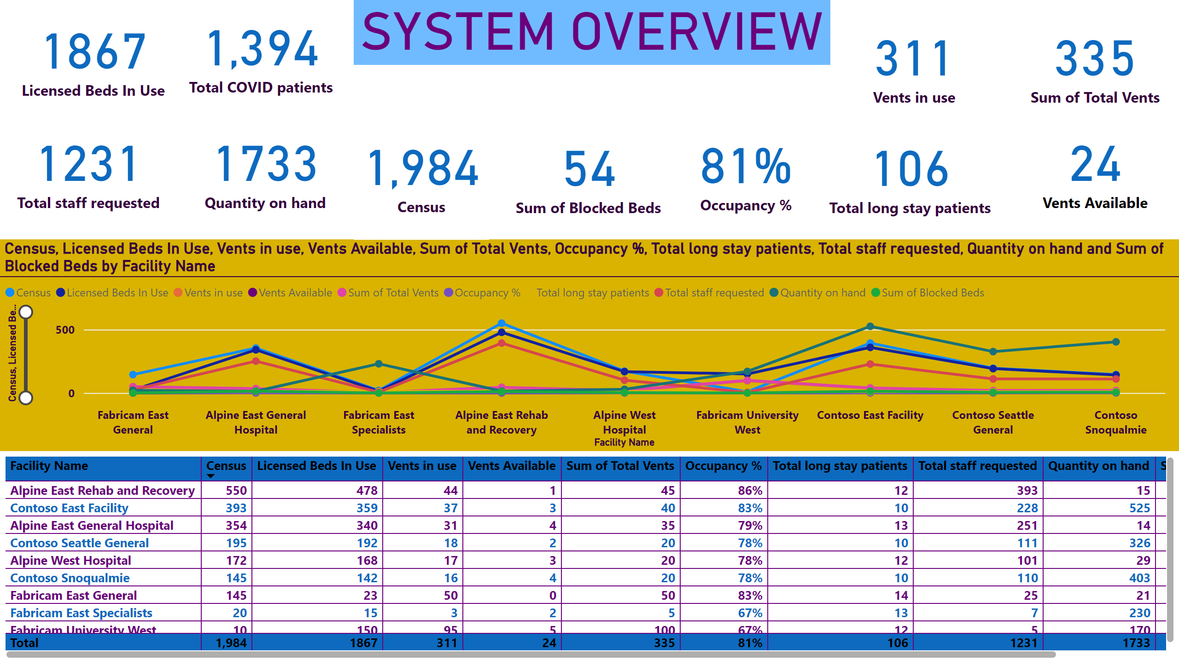
SYSTEM OVERVIEW
Notes:
card
No alt text provided
card
No alt text provided
card
No alt text provided
card
No alt text provided
card
No alt text provided
card
No alt text provided
card
No alt text provided
card
No alt text provided
card
No alt text provided
lineChart
No alt text provided
card
No alt text provided
card
No alt text provided
tableEx
No alt text provided
SYSTEM OVERVIEW
No alt text provided

Slide 3
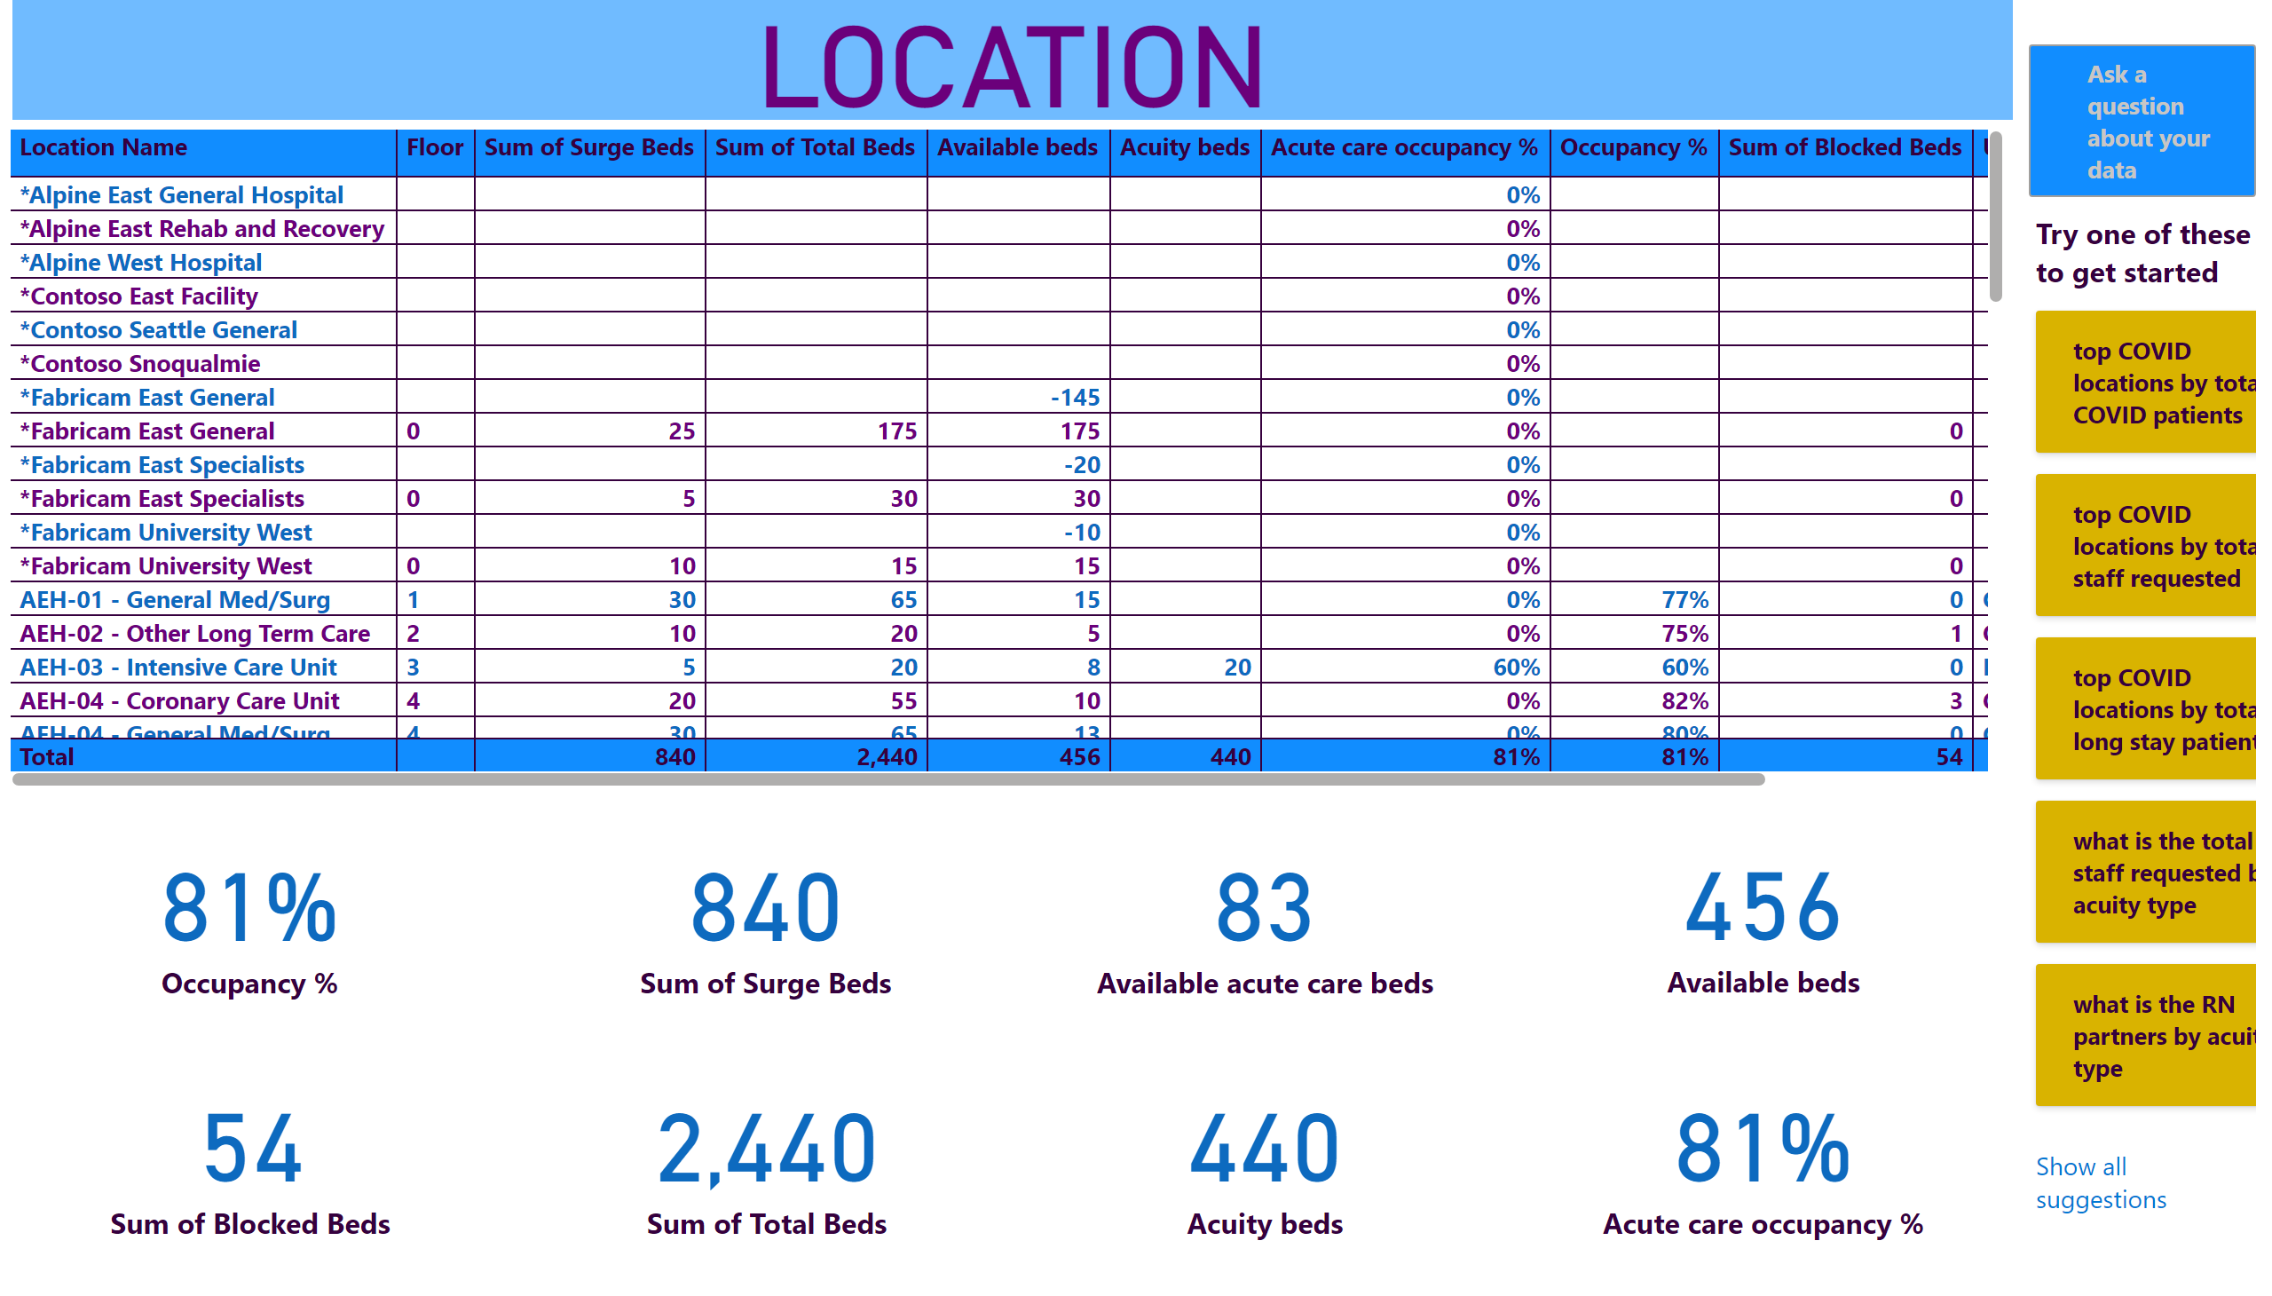
LOCATION
Notes:
tableEx
No alt text provided
card
No alt text provided
card
No alt text provided
card
No alt text provided
card
No alt text provided
card
No alt text provided
card
No alt text provided
card
No alt text provided
card
No alt text provided
qnaVisual
No alt text provided
LOCATION
No alt text provided

Slide 4
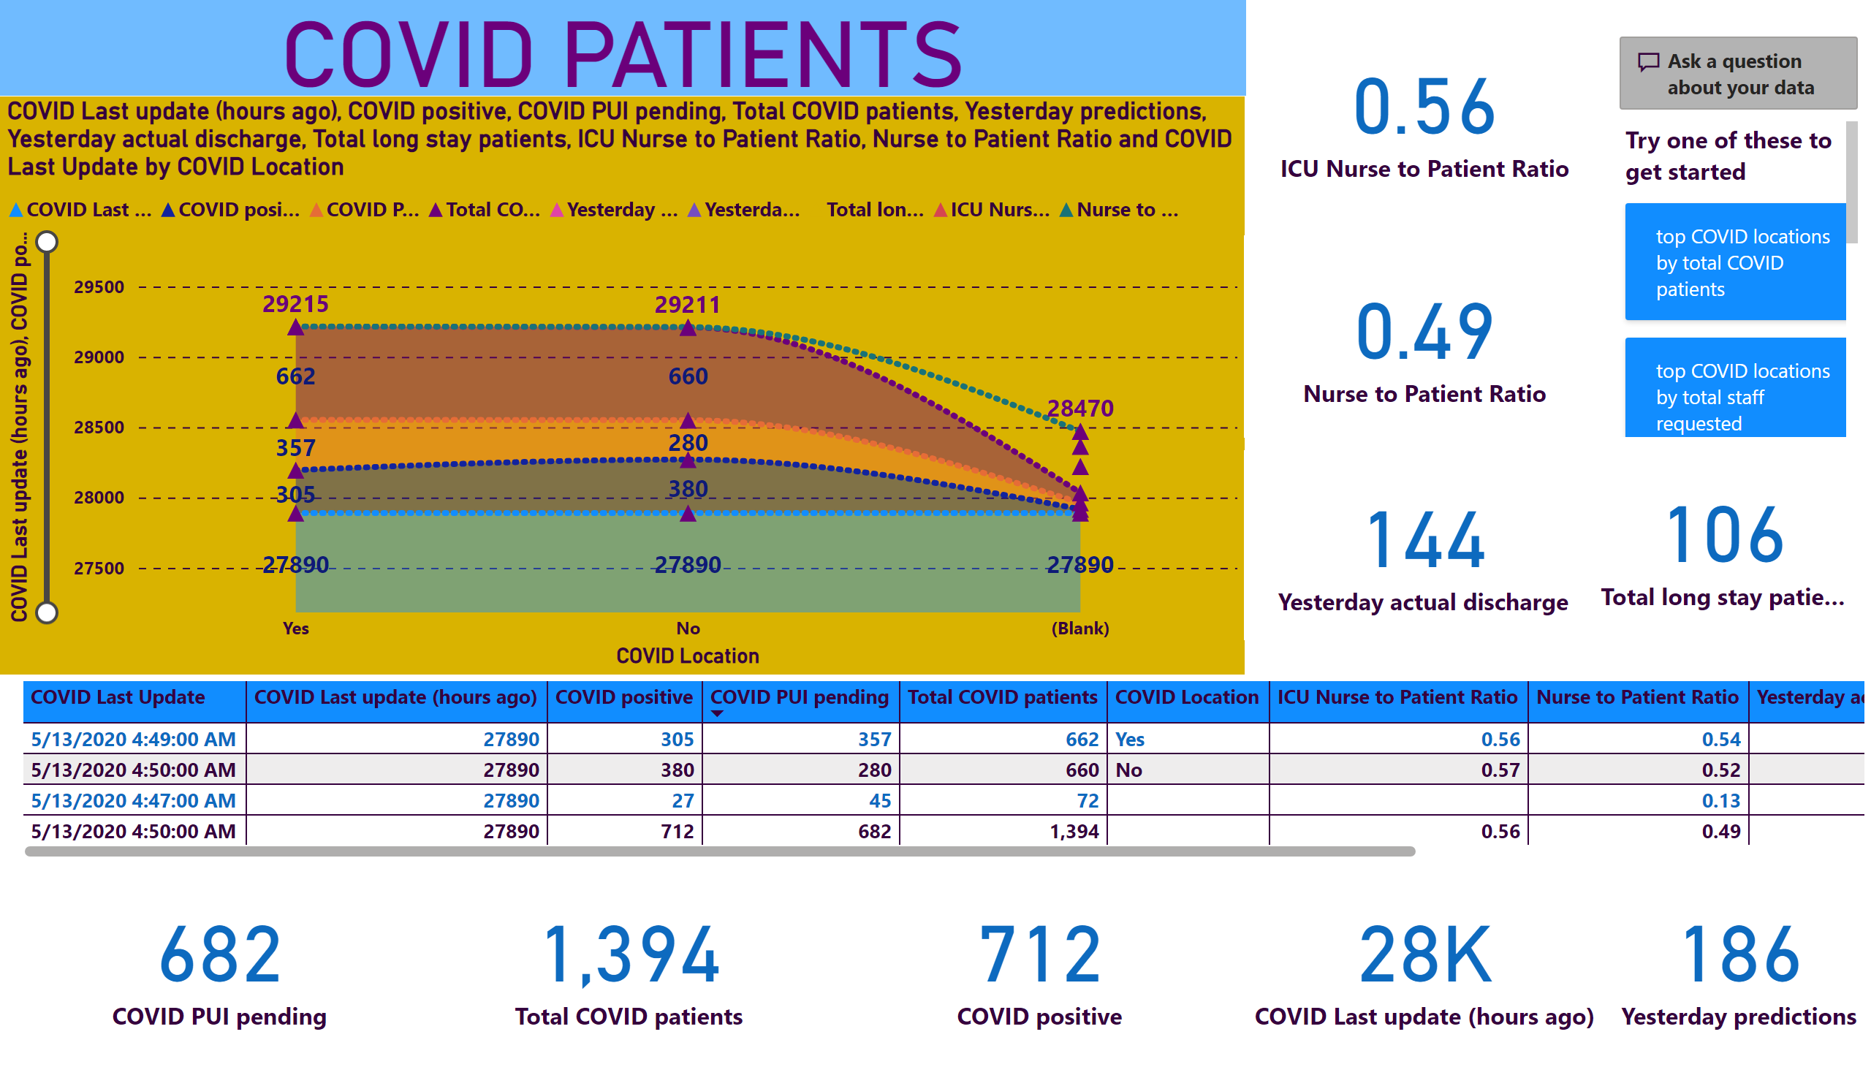
COVID
Notes:
card
No alt text provided
card
No alt text provided
card
No alt text provided
card
No alt text provided
tableEx
No alt text provided
stackedAreaChart
No alt text provided
card
No alt text provided
card
No alt text provided
card
No alt text provided
card
No alt text provided
card
No alt text provided
qnaVisual
No alt text provided
COVID PATIENTS
No alt text provided

Slide 5
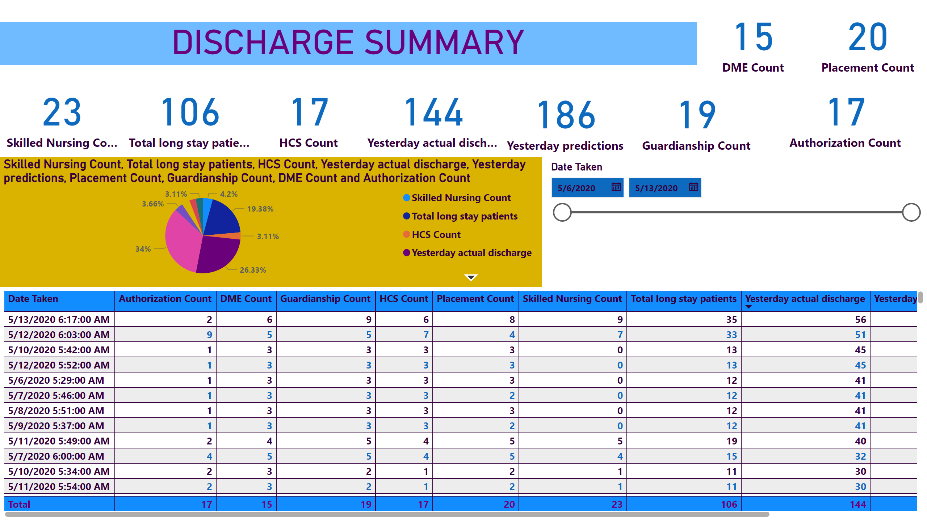
DISCHARGE SUMMARY
Notes:
DISCHARGE SUMMARY
No alt text provided
slicer
No alt text provided
tableEx
No alt text provided
card
No alt text provided
card
No alt text provided
pieChart
No alt text provided
card
No alt text provided
card
No alt text provided
card
No alt text provided
card
No alt text provided
card
No alt text provided
card
No alt text provided
card
No alt text provided

Slide 6
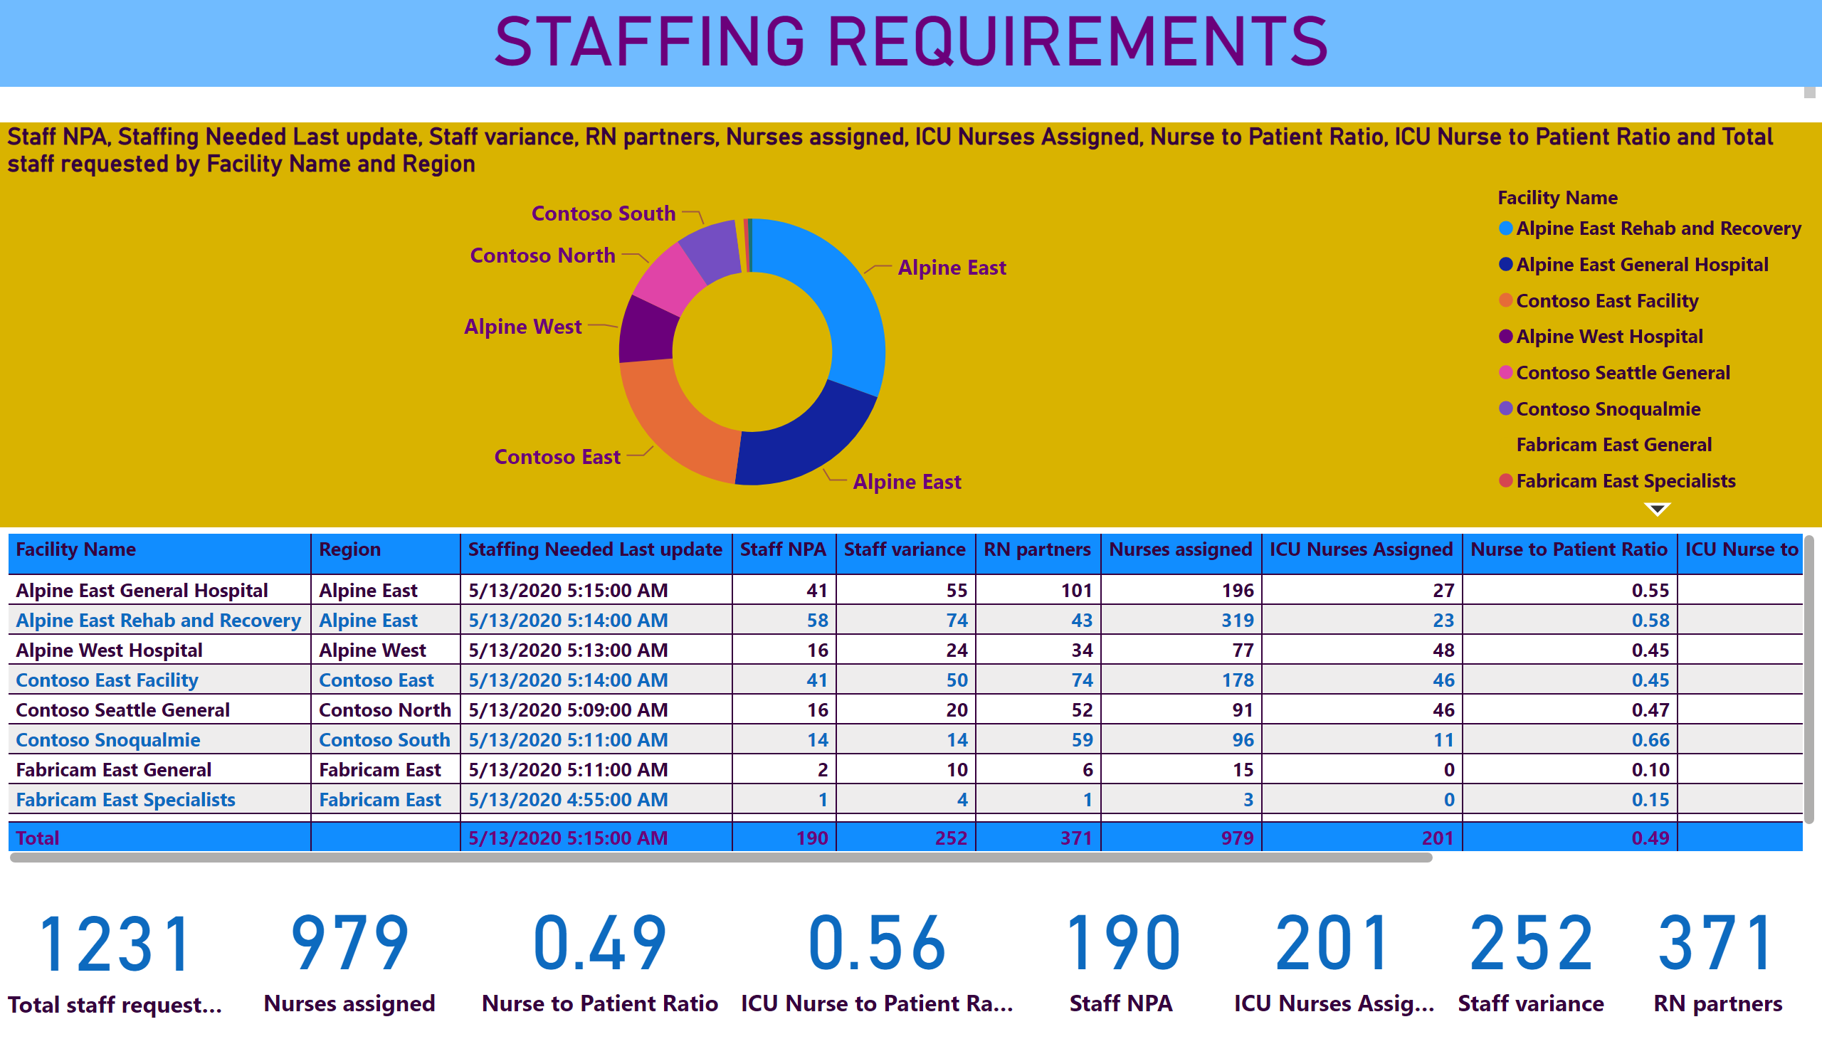
STAFFING REQUIREMENTS
Notes:
donutChart
No alt text provided
STAFFING REQUIREMENTS
No alt text provided
tableEx
No alt text provided
card
No alt text provided
card
No alt text provided
card
No alt text provided
card
No alt text provided
card
No alt text provided
card
No alt text provided
card
No alt text provided
card
No alt text provided

Slide 7
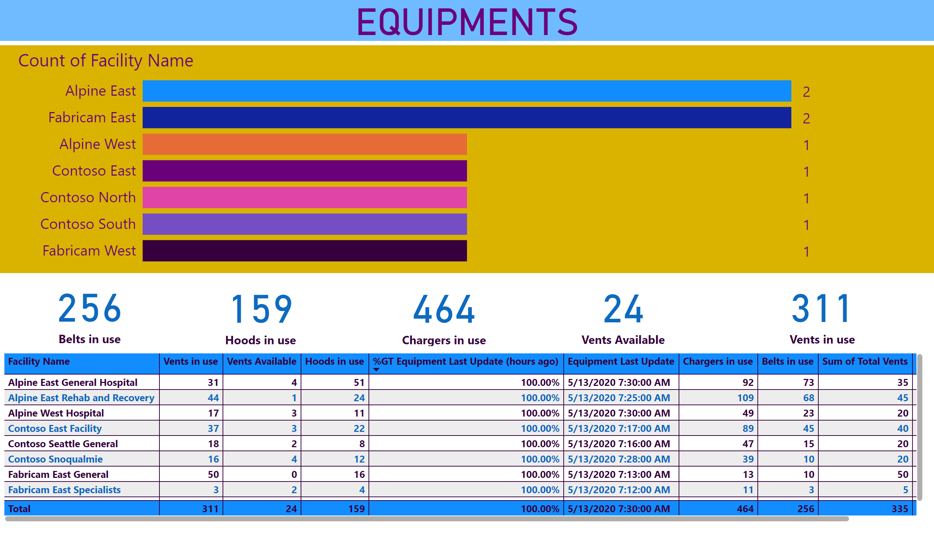
EQUIPMENTS
Notes:
tableEx
No alt text provided
EQUIPMENTS
No alt text provided
rotatingChart1823AN39DB23210918ADF752ECB2A251
No alt text provided
card
No alt text provided
card
No alt text provided
card
No alt text provided
card
No alt text provided
card
No alt text provided

Slide 8
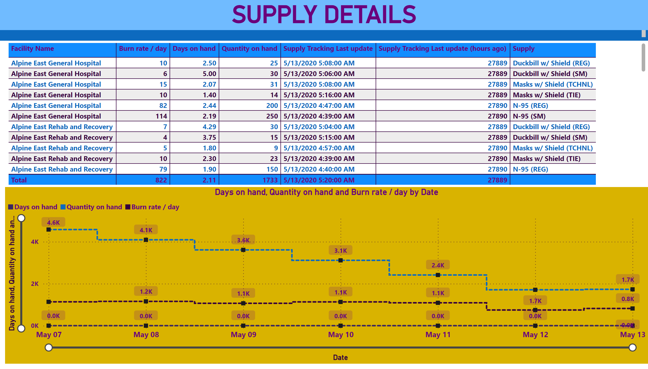
SUPPLY DETAILS
Notes:
SUPPLY DETAILS
No alt text provided
tableEx
No alt text provided
lineChart
No alt text provided

